Slide 1
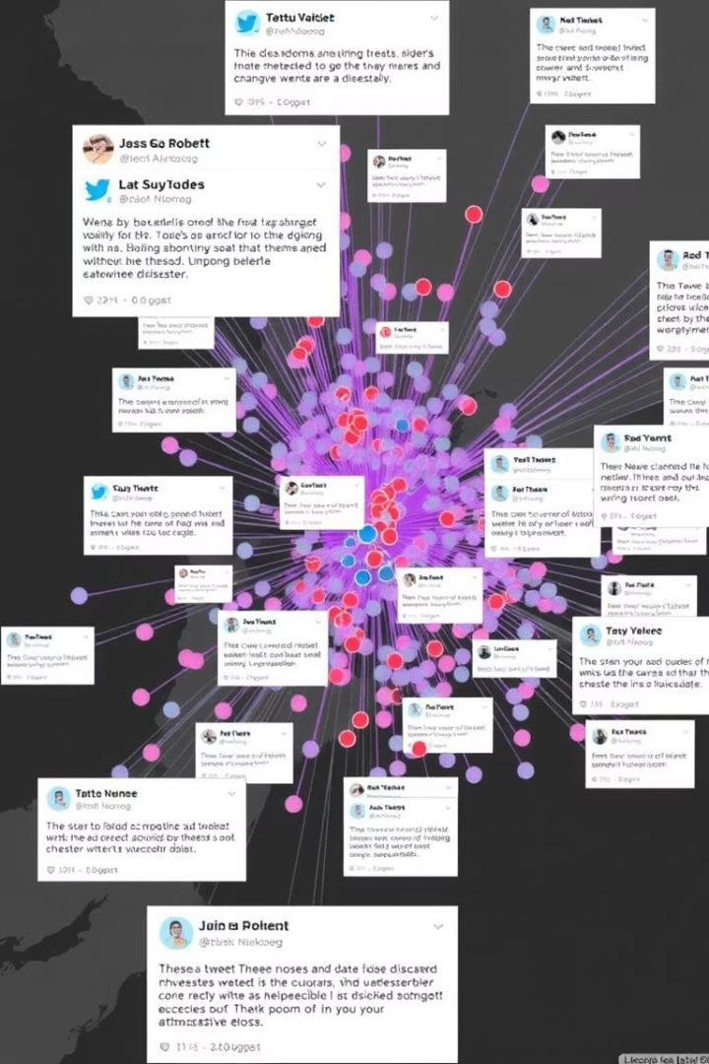

NLP Project for
Disaster Tweet Classification
In this project, I built a Tweet Classification Model to detect whether a tweet is related to a disaster or not. I started by cleaning the text—removing URLs, special characters, digits, and stopwords, and applied lemmatization to standardize the words.
I engineered additional features like sentiment polarity (using TextBlob), tweet length, hashtag count, and mention presence. These were combined with TF-IDF vectors to form the final input for the model.
I experimented with several machine learning algorithms and finalized Logistic Regression based on its accuracy and interpretability. After training, I created a real-time prediction system that takes user input, processes it, and classifies the tweet with a confidence score.
To make the model more accessible, I deployed it using Streamlit, building an interactive web app where users can test the model, explore example tweets, and download results as a CSV.
This project brought together NLP, feature engineering, machine learning, real-time prediction, and deployment to deliver a complete end-to-end tweet classification solution.
by Debasis Baidya

Slide 2







Contributions of Key Libraries & Modules to the Project
1
2
3
4
5
Pandas & Numpy
re, NLTK & TextBlob
Matplotlib, Seaborn & WordCloud
Scikit-learn (sklearn)
Scipy.sparse
I used these for loading, cleaning, and manipulating structured data and handling numerical computations.
I used these for cleaning tweet text, removing stopwords, lemmatizing, and calculating sentiment polarity.
I used these for visualizing EDA insights like class distribution, word frequencies, and generating word clouds.
I used this for TF-IDF vectorization, building ML models, evaluating performance using accuracy, F1-score, & confusion matrix.
I used this for combining sparse TF-IDF features with engineered features like sentiment score, tweet length, and hashtag count.
📊
🤖
6
7
8
9
10
Tqdm & Collections
FEE!
Transformers (Hugging Face)
Joblib & Pickle
OS & IPython.display
Streamlit
I used these for saving and loading trained models and vectorizers for real-time prediction.
I used these for monitoring loop progress and analyzing frequency of tokens and hashtags.
I used these for handling files/directories & improving output readability in the notebook.
I used this to build and deploy an interactive web app for real-time tweet classification.
I used this optionally to compare traditional models with state-of-the-art deep learning models.
🧩

Slide 3
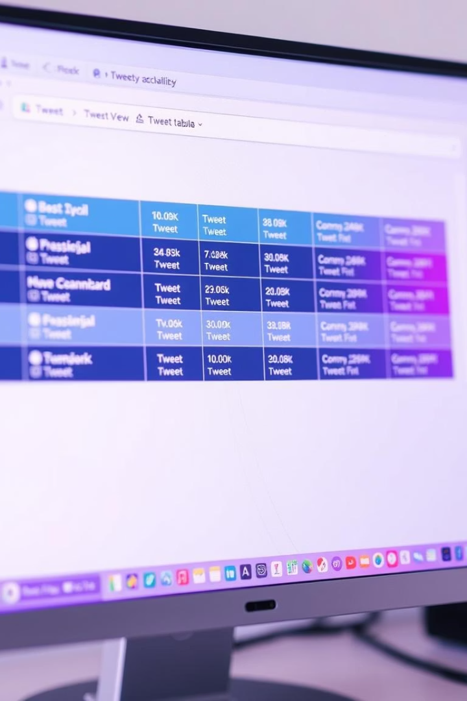
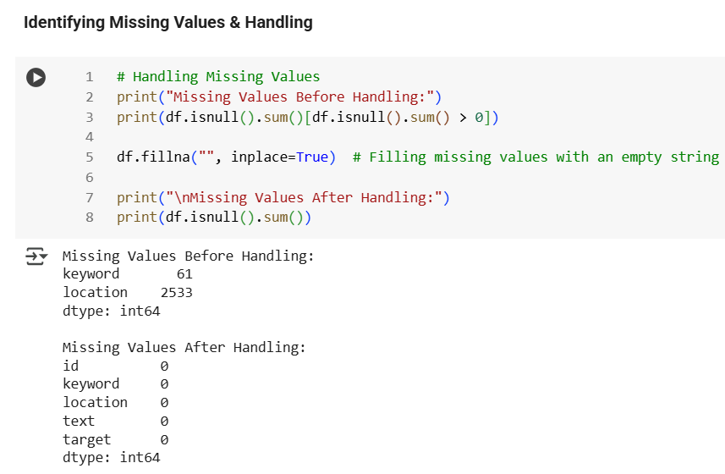
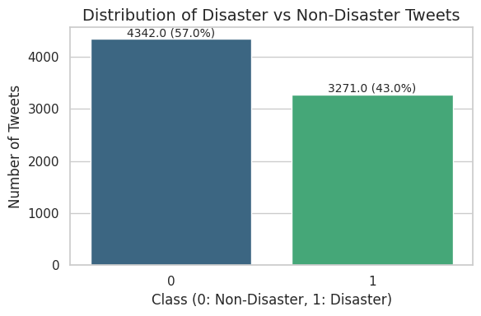
Dataset Overview
📂 Dataset Overview
Loaded dataset with 7,613 rows and 5 columns: `id`, `keyword`, `location`, `text`, `target`
Used `df.head()` to preview top 10 rows
🏗️ Data Types & Memory Usage
`id` and `target`: Integer
`keyword`, `location`, `text`: Object
Missing values found in `keyword` and `location`
⚠️ Handling Missing Values
`keyword`: 61 missing values
`location`: 2,533 missing values
Filled missing entries with empty string `""`
After handling: No missing values remained
📊 Disaster vs. Non-Disaster Distribution
Created bar plot using **Seaborn + Matplotlib**
57% Non-Disaster Tweets (4,342)
43% Disaster Tweets (3,271)
Slight imbalance, manageable without resampling

Slide 4
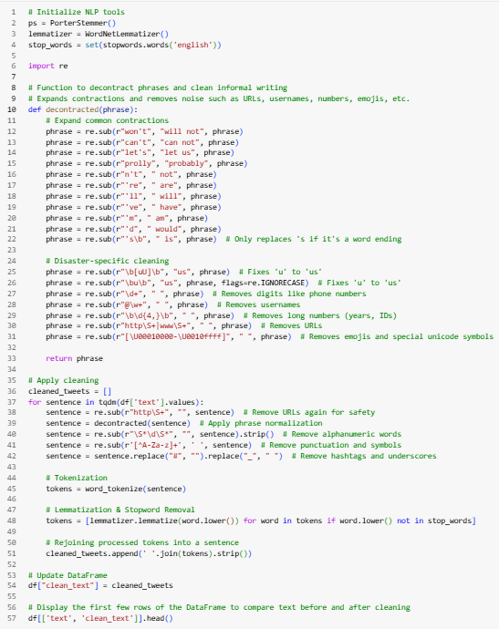
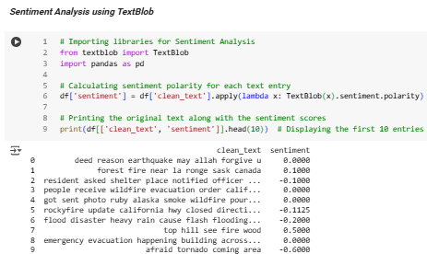
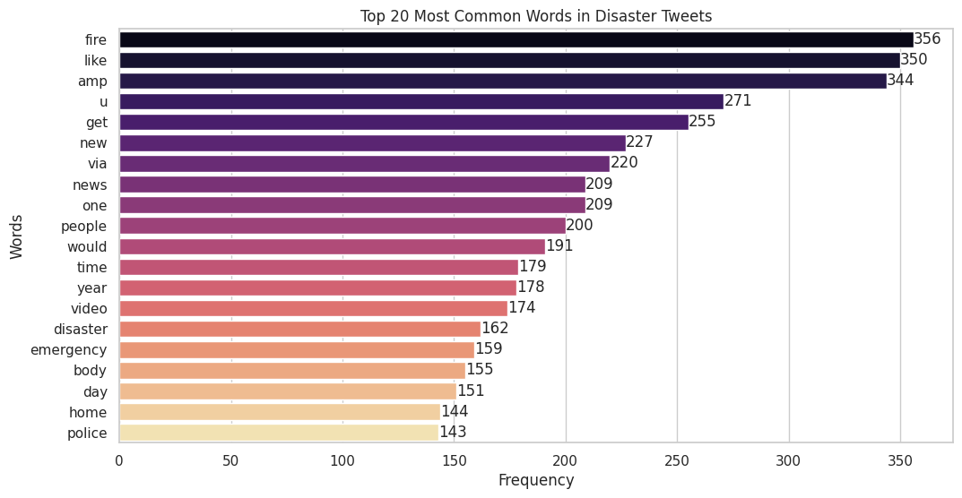
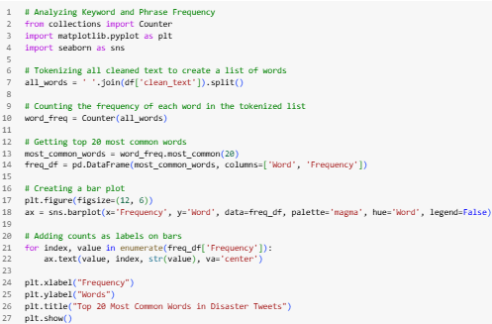
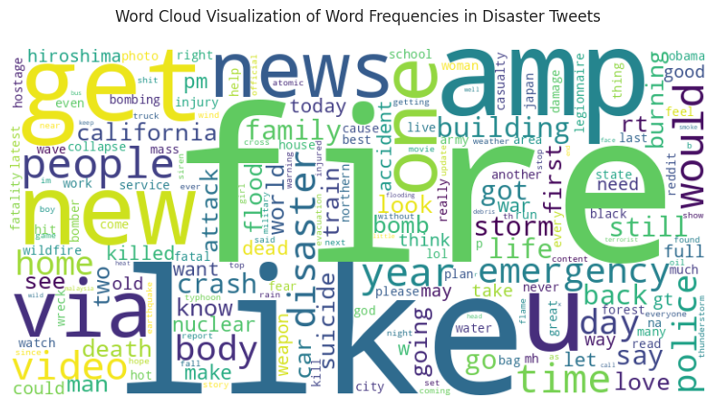
Data Cleaning & Frequency Analysis
Data Preparation & Cleaning
✔️ Removed URLs, special characters, & numbers ✔️ Lowercased 🔡 | Tokenized 🔤 | Lemmatized 📚 ✔️ Removed boring stopwords 🗑️ 🎯 Outcome: Clean, sharp text with only the good stuff left!
01
Sentiment Analysis
🧠 Used TextBlob to score each tweet’s emotional tone
📈 Polarity score from -1 (negative) to +1 (positive)
🗂️ Added a new sentiment column
✨ Helps the model understand feelings, not just words!
02
Keyword Frequency Analysis
📦 Tokenized + Lemmatized + Counted via `Counter()`
🏆 Top Words:
🐦‍🔥 fire" (356), "like" (350), "amp" (333), "get" (255), "new" (227)
🔥 Disaster words like “emergency,” “disaster,” “fire” dominate!
03
Word Cloud Visualization
🖼️ Built a Word Cloud from tokenized words
🔠 Bigger words = More mentions
🚨 Spotlight on: "fire," "emergency," "disaster," "police," "news“
📌 Confirms the theme: Disaster-Focused Tweets
04

Slide 5
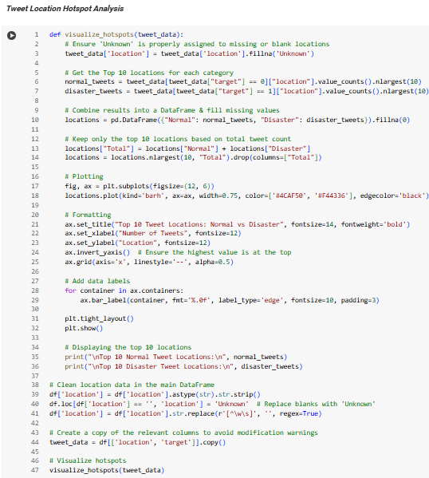
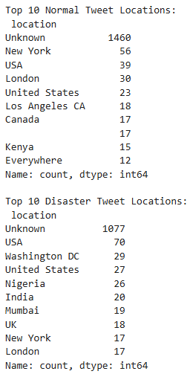
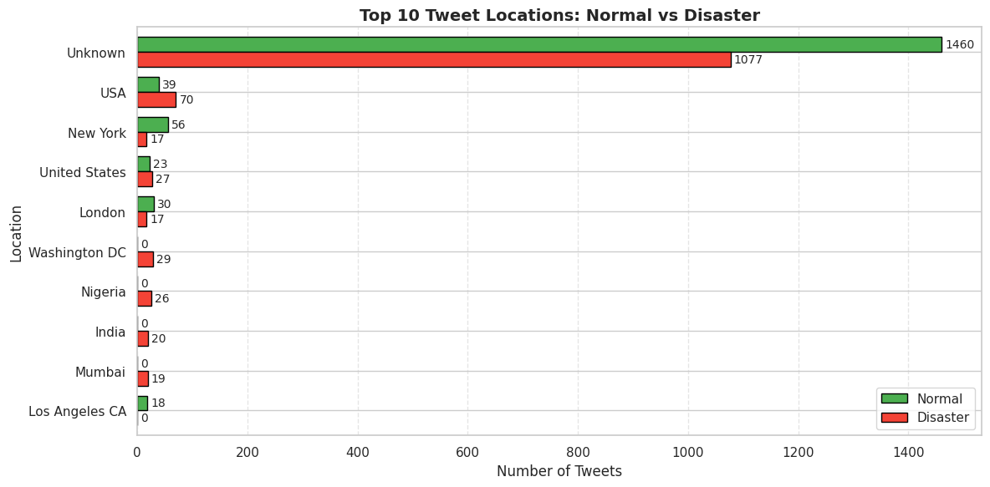
🌍 Tweet Location Analysis
📍 “Unknown” Rules the Map
1
🕵️‍♂️ Most tweets have no location data 🔸 1460 Normal | 1077 Disaster tweets = “Unknown” 📉 Shows a huge gap in geotagging on Twitter
🇺🇸 USA: Top Disaster Tweeter (Excl. Unknown)
2
🌪️ 70 Disaster Tweets vs. 39 Normal from the USA 🧭 Suggests stronger disaster awareness, reporting, or tagging in the U.S.
🗽New York Talks, But Not About Disasters
3
🗨️ 56 Normal Tweets vs. only 17 Disaster Tweets ⚖️ High general activity, but fewer tweets tagged as disasters
🌐 Disaster-Only Locations Appear
4
📍 Nigeria, India, UK, Washington DC, Mumbai 🚨 These regions only pop up during disasters, not in normal tweeting
📣 Global South: Loud in Crisis
5
🌏 Countries like India & Nigeria show up in disasters 📢 May reflect higher alertness or public concern during emergencies
🌆 Urban West = Normal Tweet Hotspots
6
🗺️ London, NYC, LA, Canada lead normal tweeting 💡 Suggests routine Twitter use is higher in urban, developed regions
🏛️Washington DC: All About Disaster
7
📊 29 Disaster Tweets | 0 Normal Tweets 📡 Possibly due to news media, alerts, or official comms

Slide 6
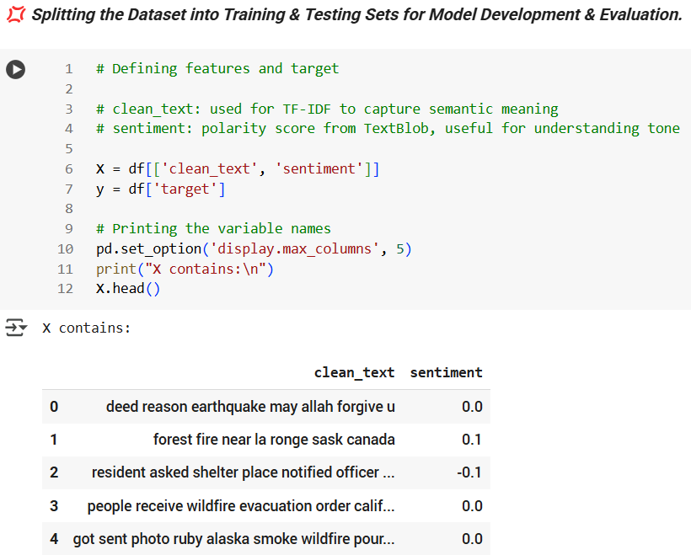
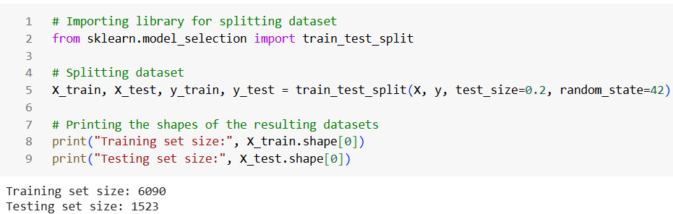
💢 Splitting the Dataset into Training & Testing Sets for Model Development & Evaluation
🧠 Feature Setup
1
Features (X) include:
✅ Cleaned Tweets 🧹
✅ Sentiment Scores from TextBlob
💬Together, they form a rich dataset of 7613 entries
➕ Sentiment adds emotional context to raw text!
🎯 Target Variable
2
y holds the binary labels:
1 → Disaster Tweet 🚨
0 → Normal Tweet 🕊️
A clean and simple setup for supervised learning!
✂️ Train-Test Split Summary
Used an 80/20 ratio for training and testing:
🧪 Training set: 6090 entries
🧪 Testing set: 1523 entries
Ensures the model learns well and is tested fairly
3
📌 Bottom Line
✅ The dataset is now model-ready, complete with smart
Features & clear labels
✅ Split cleanly to enable robust model development &
accurate evaluation 🚀📊
4

Slide 7
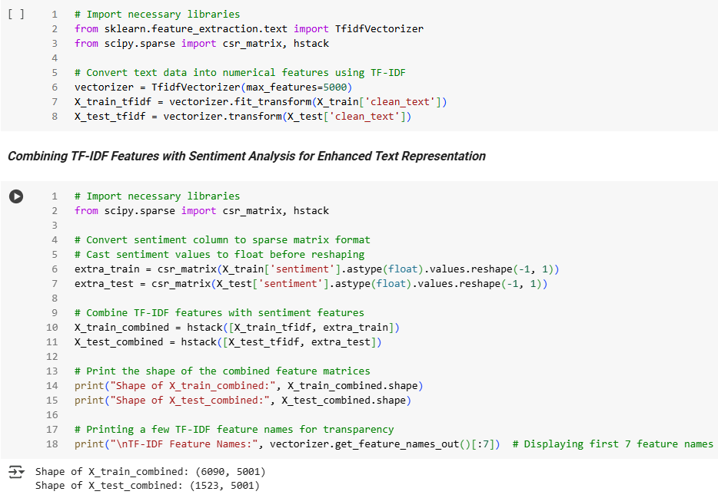


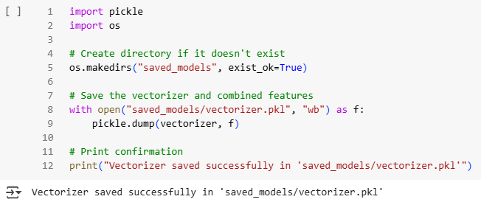
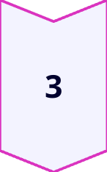
TF-IDF & Sentiment-Based
Feature Engineering & Class Balancing
🧾 TF-IDF Vectorization
Cleaned tweets transformed into numerical vectors using TfidfVectorizer
🔢 Feature cap set to 5000 to maintain balance
📏 Matrix sizes:
Training → (6090, 5000)
Testing → (1523, 5000)
🧪 Printed sample features like 'aa', 'ab', 'aba' for transparency
💾 Vectorizer saved in saved_models/ for reuse
💬 Sentiment Added as a Feature
Used TextBlob polarity to score tweet tone
➕ Converted sentiment column into a sparse matrix
🔗 Merged with TF-IDF vectors
Gives tweets an emotional dimension — not just text!
📌 Takeaway
A powerful combination of semantic (TF-IDF) and emotional (sentiment)
features enhances the model's understanding of tweet content. 🔍📊

Slide 8
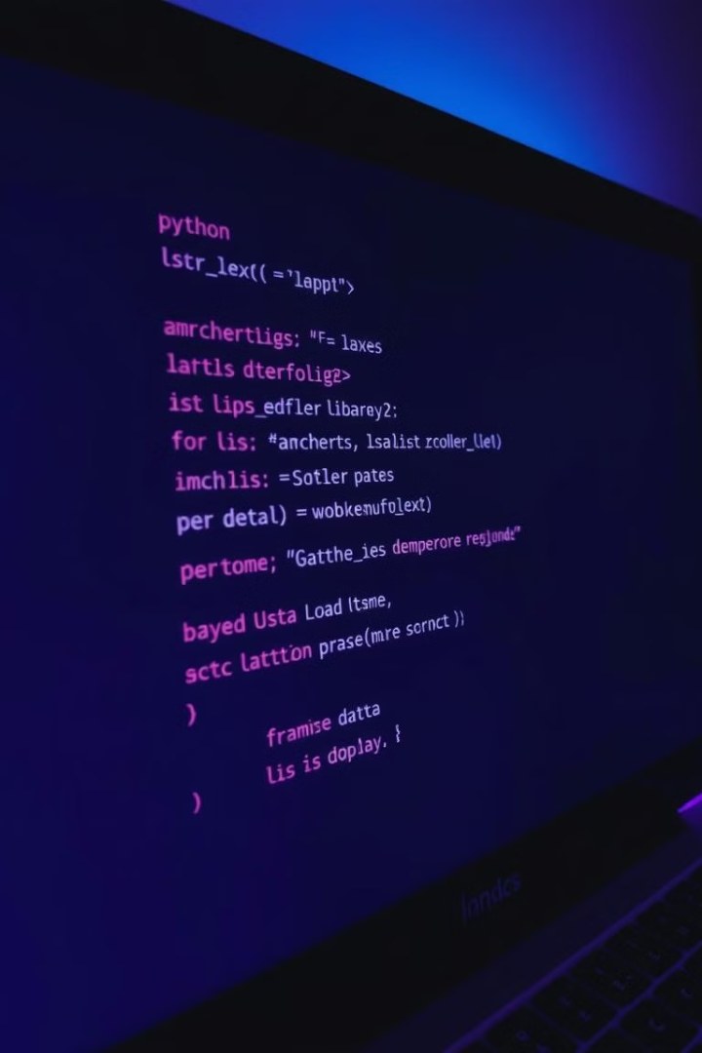
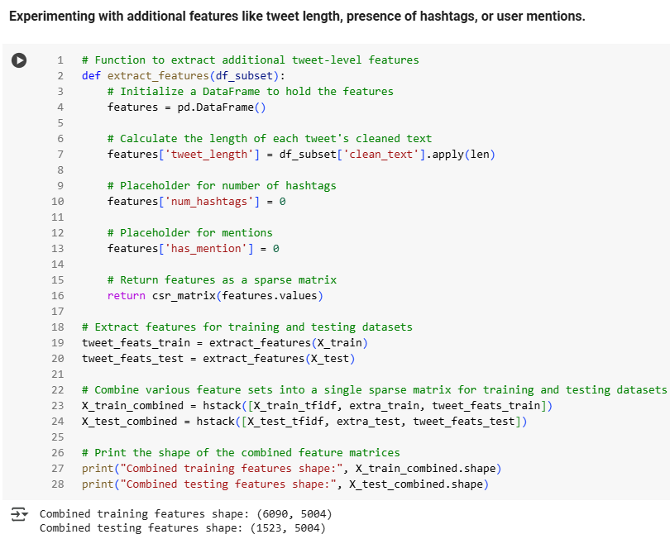
Tweet-Level Features & Final Feature Matrix
🛠️ Extra Tweet-Level Features
1
Extracted tweet length as a numeric feature
Added placeholders for:
🔢 Number of hashtags
🔗 Number of mentions
These help provide context beyond words
🧩 Combining It All: One Unified Feature Set
2
Final matrix combines:
✅ TF-IDF vectors: Max 5000 features
✅ Sentiment scores: Emotional Tone alongside raw text content
✅ Tweet-level features: ✅ Tweet length, #️⃣ Hashtags & 👥 Mentions
🧮 All merged into a single sparse matrix — compact, efficient,
and information-rich
⚠️ The Problem
3
📉 Original Dataset Was Imbalanced:
🕊️ Normal Tweets (Class 0): 3468
🚨 Disaster Tweets (Class 1): 2622
⚠️ Risk: Model might favour the majority class, leading to skewed predictions and lower performance on disaster detection.
🔁 The Fix — SMOTE
3
🧪 Balanced the dataset by synthetically generating new disaster tweet samples to match the majority class.
📊 Post-SMOTE Class Counts:
✅ Class 0 (Normal): 3468
✅ Class 1 (Disaster): 3468
🎯 This ensures fairer learning and reduces model bias toward the majority class.

Slide 9
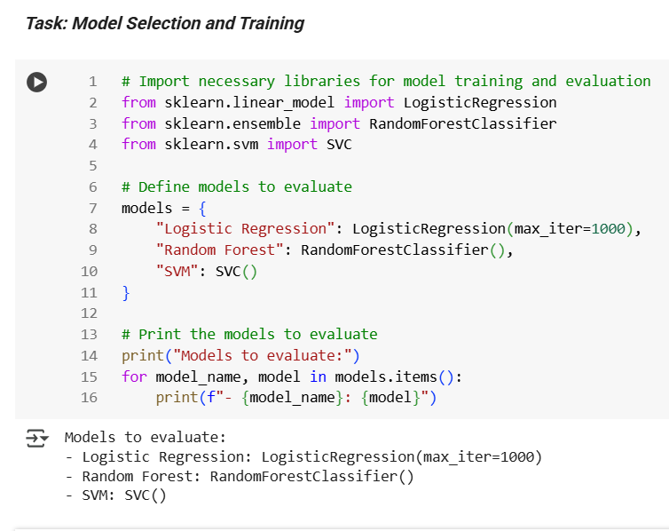
Selecting the Right Model
⚙️ Models Explored for Training:
STEP
01
To identify the best fit, I tested these three powerful classifiers:
✅ Logistic Regression
🌲 Random Forest
📈 Support Vector Machine (SVM)
All models were initialized with basic parameters & verified for correct setup. 🛠️🧪
🧠 Logistic Regression:
STEP
02
✅ Set max_iter =1000 to ensure smooth convergence
✅ Extremely efficient with TF-IDF and added features
✅ Quick, accurate, and reliable
🌲 Random Forest
STEP
03
☑️ Great at handling complex feature sets
🐦‍🔥 Should perform decently but is a bit resource-intensive & slower
🦋 Best used when interpretability isn't a top priority
📈 SVM
STEP
04
💪🏻 Known for strong performance in text classification
⏳ Required more time and hyperparameter tuning
🤷🏻‍♂️ Less practical here due to slower training time

Slide 10
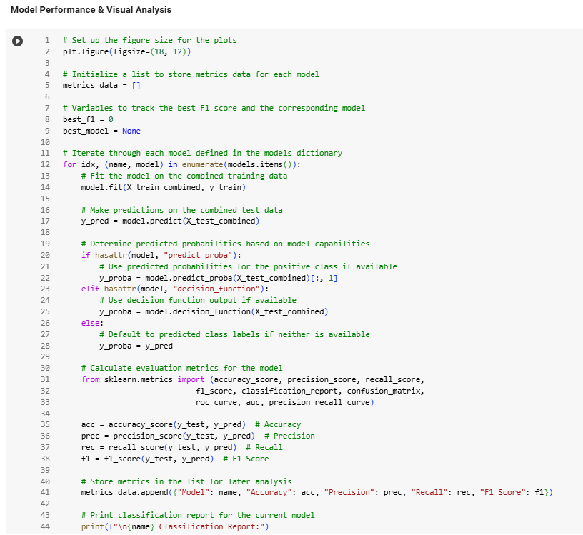
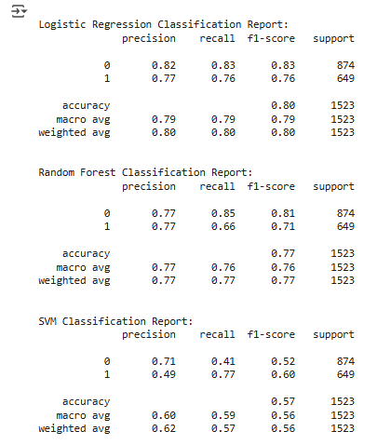
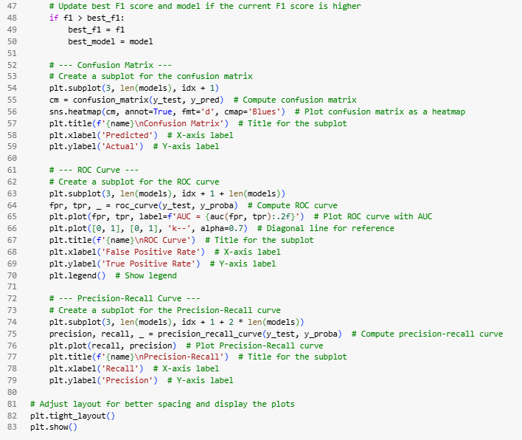
Model Performance – Metrics at a Glance
01
1️⃣ Logistic Regression Leads with Consistency
✅ Accuracy: ~80%
✅ F1 Score: ~0.80
✅ ROC AUC: ~0.86
✅ Precision-Recall: High & Stable
02
2️⃣ Random Forest Delivers Competitive Results
✅ Accuracy: ~77%
✅ F1 Score: ~0.77
✅ ROC AUC: ~0.84
⚠️ Slightly more misclassifications for disaster tweets
03
3️⃣ SVM Falls Short for This Problem
❌ Accuracy: ~57%
❌ F1 Score: ~0.56
❌ ROC AUC: ~0.63
❌ Precision-Recall curve drops sharply

Slide 11
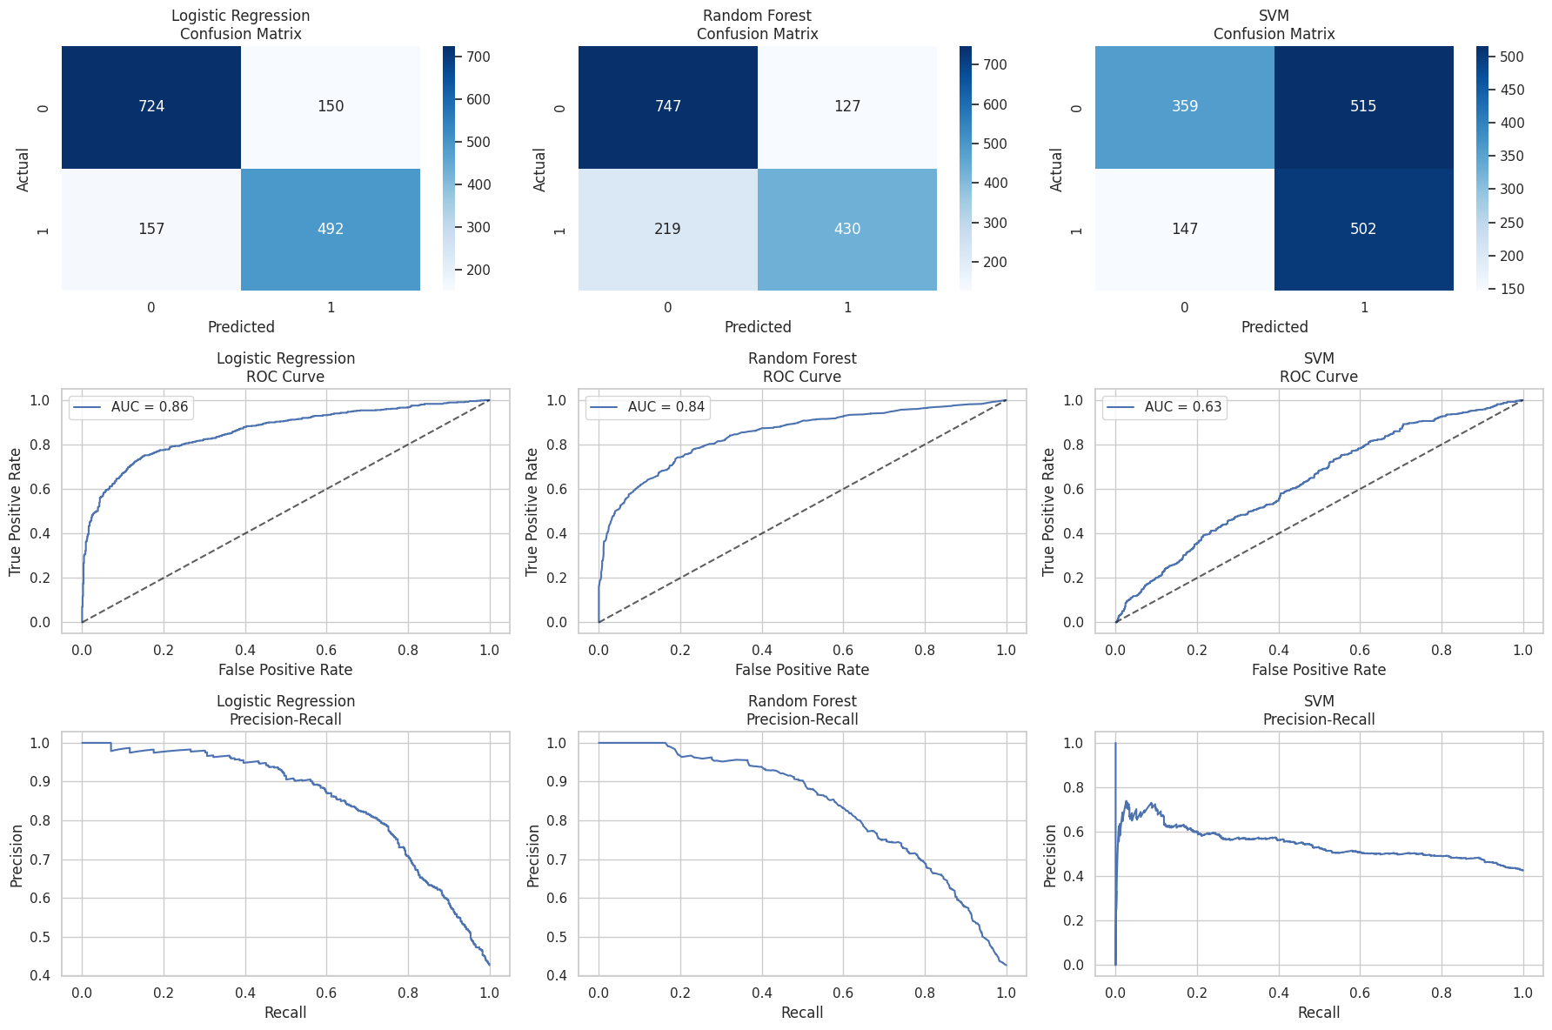
Visual Evaluation – What the Charts Say
✅ Confusion Matrices:
📈 ROC Curves:
📉 Precision-Recall Curves:
Logistic Regression: Strong diagonals, better class distinction
SVM: Lighter matrix, more errors & confusion
Logistic Regression:
Tops with AUC ~0.86
Random Forest:
Close second with AUC ~0.84
SVM:
Lowest, AUC ~0.63
Logistic Regression:
High precision across recalls
Random Forest:
Steady, but dips slightly
SVM:
Sharp drop, lower overall precision

Slide 12
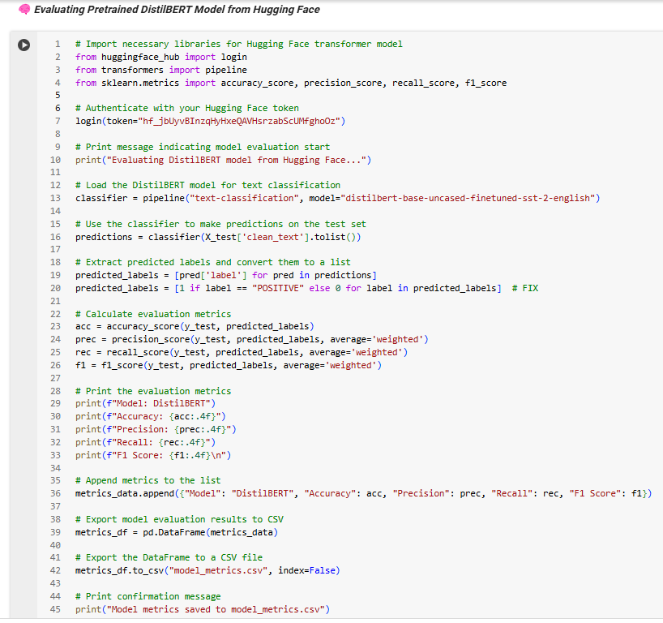
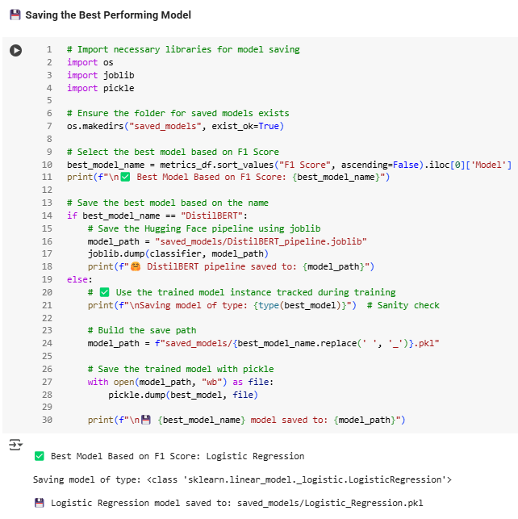
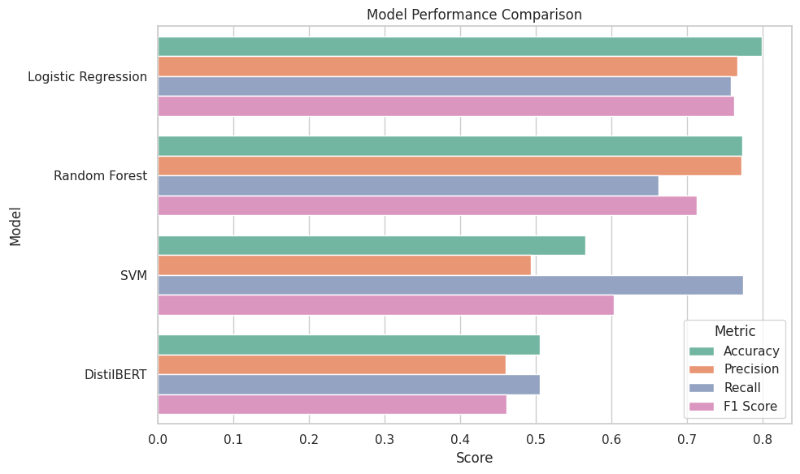
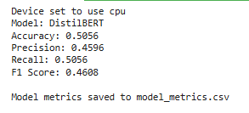
Model Comparison & Best Model Determination & Auto-Saving
🔍 Custom Models vs. DistilBERT
I compared my tailored models (Logistic Regression, Random Forest, SVM) against the pretrained DistilBERT 🤖 from Hugging Face.
📊 Custom Model F1 Score: ~0.80
😕 DistilBERT F1 Score: ~0.46 (no fine-tuning)
Visuals (Confusion Matrix, ROC, Precision-Recall) clearly favoured the custom setup 💡
01
🏆 Best Model Determination & Saving 💾
✅ The Custom Model emerged as the top performer 🏆
📊 Logged performance metrics in model_metrics.csv 📈
💾 Saved the best model in the saved_models directory using pickle 🔐
02
📌 Bottom Line
🧠 A domain-tuned model outperformed a generic transformer 🤖
🚀 The best model is stored & good to go for deployment ✅🎯
03

Slide 13
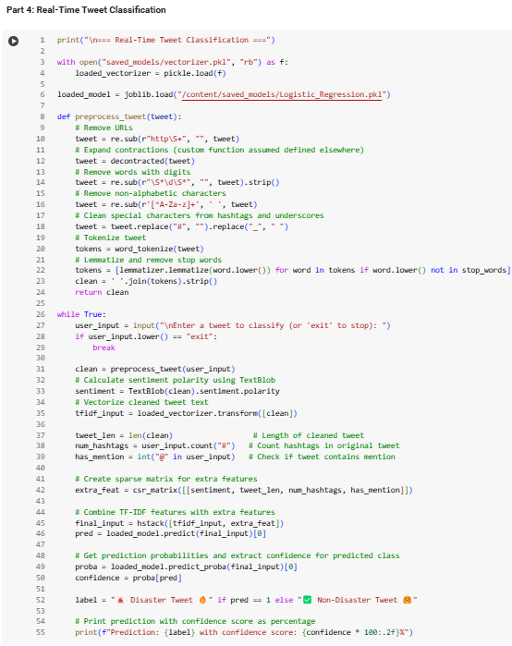
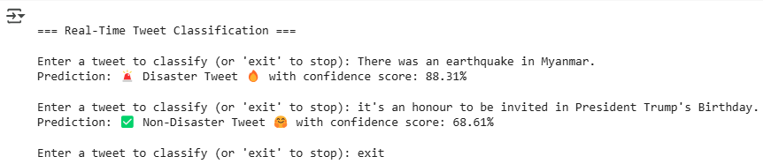
Real-Time Tweet Classification Performance
01
📌 Live Testing with User-Entered Tweets
🚀 Ran the model on fresh, unseen tweets to check real-world performance.
🌋 Tweet: "There was an earthquake in Myanmar" → Predicted as
🚨 Disaster Tweet with 84.05% confidence.
🎉 Tweet: "it's an honour to be invited in President Trump's Birthday" → Predicted as
✅ Non-Disaster Tweet with 73.86% confidence.
02
🧠 Boosted Accuracy with Rich Features
🧩 I enriched the classification by combining TF-IDF vectors with smart features like:
🧾 Tweet length
❤️ Sentiment score
🔢 Hashtag count
👤 Mentions (@) presence
⚡ Results
03
03
Fast, consistent, and reliable predictions ✅
Acted as a mini deployment simulation, showing strong performance outside the test set 🔍
The model confidently handles real-world inputs — it's not just trained, it's ready to serve
insights on live data! 🎯📲

Slide 14
🚀 Disaster Tweet Detector — Streamlit App Overview
🔗 Live App: Disaster Tweet Detector 🚨🧠
🌪️ Disaster Tweet Detector
📊 Tweet Analysis
STEP
01
STEP
06
Extra insights like sentiment, length, hashtag count, mentions, and emoji use 🧠.
Built a clean, easy-to-use app to classify tweets as 🚨 Disaster or ✅ Non-Disaster.
✍️ Live Input or Example Tweets
⬇️ Download Prediction
STEP
02
STEP
07
Enter your own tweet or click an example to auto-fill instantly 🚀.
Segmented session durations into deciles, revealing patterns in data usage.
🔍 Predict Button
⚡ Fast & Smooth UX
STEP
03
STEP
08
One click analyzes the tweet, predicts category, shows confidence % and mood 🎯.
Save your tweet analysis as a CSV with just one click 📥.
🧹 Reset All
🤖 Powered By
STEP
04
STEP
09
One click clears results, double click clears tweet input too for a full reset 🧼✨.
Prediction, visualization, and reset all work instantly without weird reloads 🚀.
📈 Confidence Breakdown
🚀 Real-World Ready
STEP
05
Neat pie chart showing prediction probabilities side-by-side 🍰.
STEP
10
Logistic Regression model trained on TF-IDF + smart features like sentiment, length, hashtags, mentions 🔥.
FRE!

Slide 15
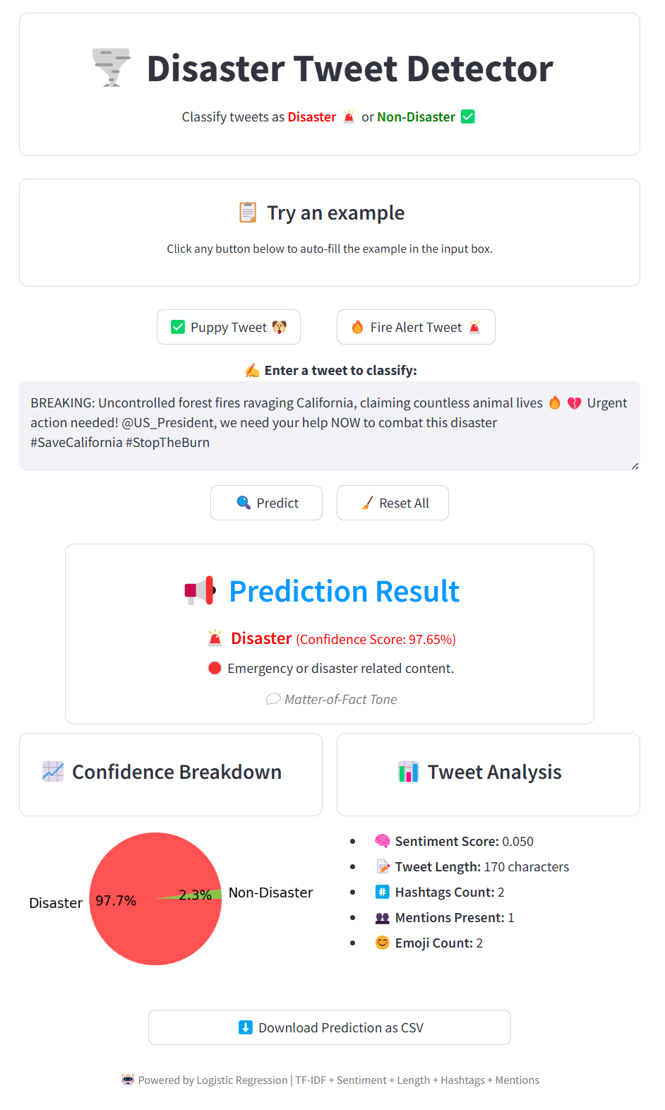
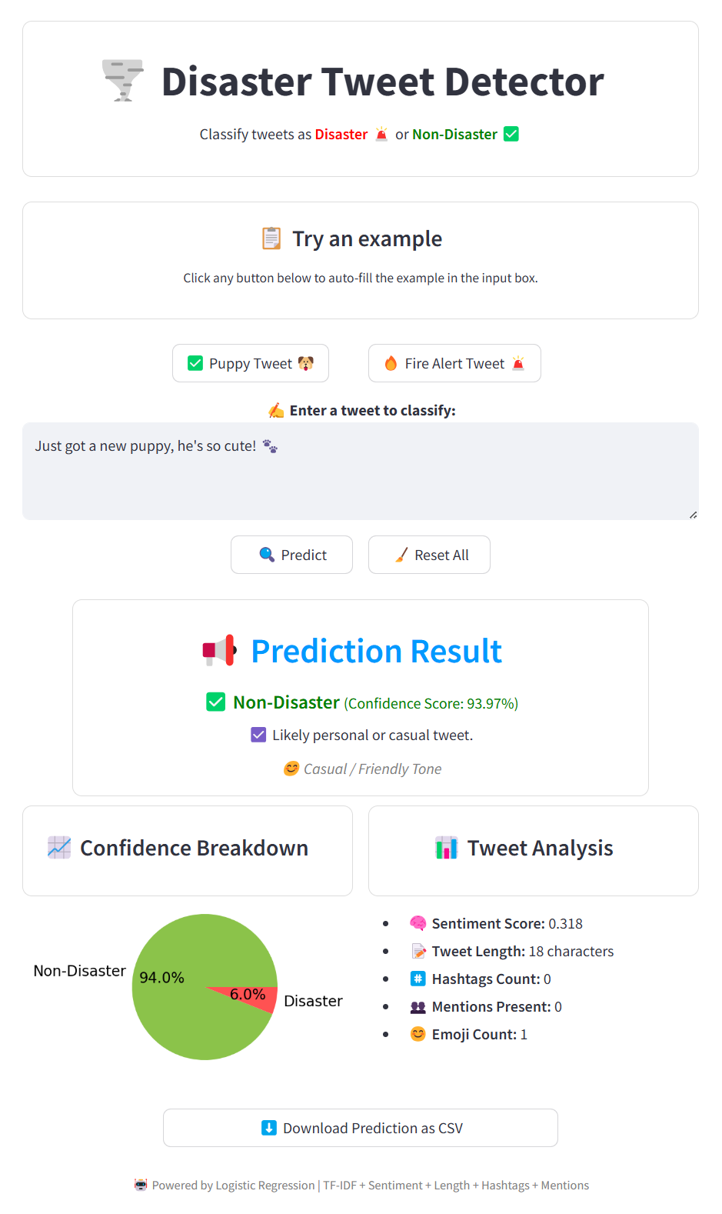
🎨 Sleek & User-Friendly Streamlit Interface for
Real-Time Tweet Analysis
01
🔵 Centralized Layout
Every button, example, & output is thoughtfully center-aligned for a clean, professional look 🎯
02
🟠 Instant Example Loading
Example tweets load immediately into the input box without refreshing the page. ⚡
03
🟣 Consistent Design
Matching boxed sections for prediction, analysis & pie charts keep the UI smooth & intuitive. 🎨
04
Data Insertion
Used a MERGE statement to insert or update user scores based on the existing records in the table.

Slide 16
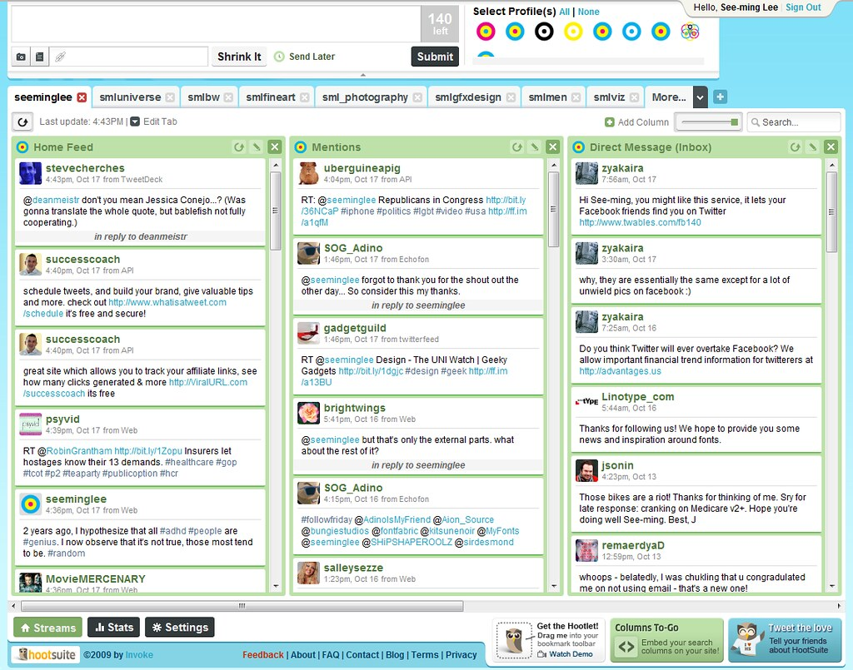
THANK YOU
We appreciate your time and attention. We hope this presentation was informative and helpful.
For any questions or further assistance, please feel free to reach out.
Notes:
Links:
https://unsplash.com/photos/SYTO3xs06fU

